Slide 1

Image to Text Interactive System
for PDF Documents
Honors Project Phase I Review II
Ashutosh Rai
Roll.No: 2020BCS0020
Guided by: Dr. Selvi C
Department of Computer Science and Engineering
Indian Institute of Information Technology Kottayam
April 13, 2023
Image to Text Interactive System for PDF Documents Ashutosh Rai – 2020BCS0020 Ashutosh Rai – 2020BCS0020

Slide 2
Introduction
Large amounts of data is generated in today’s age, stored in the form of structured, semi- structured and unstructured document - image.
Extracting relevant information from these is a challenging and time-consuming task, which the proposed system tries to solve.
The Image to Text Interactive System works by extracting textual information from images of literature and invoice documents and returning an answer to the user query.
System makes use of techniques like OCR (Optical Character Recognition), layout parsing and VDU (Visual Document Understanding) to overcome limitations of OCR-based methods.
Image to Text Interactive System for PDF Documents Ashutosh Rai – 2020BCS0020 Ashutosh Rai – 2020BCS0020

Slide 3
Introduction
LLMs (Large Language Models) have shown impressive performance on various language tasks, but aren’t optimized for the specific task of extracting information from document images, where a holistic understanding of the layout and structure of the document is required. And they are computationally expensive and time consuming to train.
Image to Text Interactive System for PDF Documents Ashutosh Rai – 2020BCS0020 Ashutosh Rai – 2020BCS0020

Slide 4
Problem Statement
The problem at hand is the lack of an effective and user-friendly AI-based image-to-text Q/A system that can perform template-free information retrieval from images. Currently available solutions require large datasets for training and have limited user-friendly interfaces, making it difficult for end-users to efficiently extract information from images. The proposed system should overcome these limitations by providing a user-friendly Q/A interface and the ability to perform information extraction from images without the need for extensive training datasets or complicated interfaces.
Image to Text Interactive System for PDF Documents Ashutosh Rai – 2020BCS0020 Ashutosh Rai – 2020BCS0020

Slide 5
Literature Review
S no. | Author(s) & Publication Year | Study Title | Key Findings | Limitations | Relevance to Project | Study Type
1 | LeCun, Yann et al. 2020 [3] | Document Information Extraction in the Age of Deep Learning | Describes state-of-the-art techniques for document information extraction using deep learning | General review article, no specific research study | Provides overview of current research in the field | Review Article
2 | Skalický, M., Šimsa, Š., Uřičář, M., & Šulc, M. 2018 [7] | Document Information Extraction for Business Processes | Describes implementation of document information extraction system for invoice processing in a large corporation | Limited to specific use case, not a generalizable study | Provides example of successful implementation of document information extraction system | Case Study
Image to Text Interactive System for PDF Documents Ashutosh Rai – 2020BCS0020 Ashutosh Rai – 2020BCS0020

Slide 6
Literature Review
3 | Qian, Tie-Yan et al. 2019 [4] | Natural Language Queries for Business Intelligence: A Survey | Provides overview of natural language query systems for business intelligence | Limited to natural language query systems for business intelligence, not document information extraction specifically | Provides insights into natural language query systems and potential applications in document information extraction | Review Article
4 | Roy, Pradeep Kumar et al. 2018 [5] | A Survey of Techniques for OCR Error Correction | Provides overview of techniques for correcting errors in optical character recognition | Focuses on OCR error correction, not document information extraction specifically | Provides insights into techniques for correcting errors in OCR, which may be applicable to document information extraction | Review Article
5 | Shi, Baoguang et al. 2016 [6] | An End-to-End Trainable Neural Network for Image-Based Sequence Recognition and Its Application to Scene Text Recognition | Describes a deep learning method for recognizing text in images | Focuses on image-based text recognition, not document information extraction specifically | Provides insights into deep learning methods for recognizing text in images, which may be applicable to document information extraction | Research Article
Image to Text Interactive System for PDF Documents Ashutosh Rai – 2020BCS0020 Ashutosh Rai – 2020BCS0020

Slide 7
Literature Review
The paper authored by Tuan Lai, Quoc Le, and Minh-Thang Luong [11] discusses the limitation of limited dataset size and lack of diversity in document types as limitations.
The paper by Jinfeng Rao, Huaishao Luo, and Jimmy Lin faces [12] discusses about limitations in its ability to handle complex queries and diverse document types.
The proposed model by Minjoon Seo, Aniruddha Kembhavi, Ali Farhadi, and Hannaneh Hajishirzi [13] discusses the limitation of having a limited ability to reason beyond surface-level information.
Image to Text Interactive System for PDF Documents Ashutosh Rai – 2020BCS0020 Ashutosh Rai – 2020BCS0020

Slide 8
Literature Review
Chen Zhao, Luheng He, and Mari Ostendorf, in their paper [14] identify a limitation in their proposed system: the limited ability to handle complex document structures.
Image to Text Interactive System for PDF Documents Ashutosh Rai – 2020BCS0020 Ashutosh Rai – 2020BCS0020

Slide 9
Methodology
User-friendly GUI: Provides a simple interface where the user uploads the document image and query, and selects the document type.
Literature document text extraction: Image passes through Layout Parser, which selects the ROIs and then Tesseract OCR extracts the text, which is used as context by the Q/A system to return an answer to the user query.
Invoice document text extraction: The DONUT model extracts the textual information which is parsed as JSON, which is then processed along with user query using NLU to extract the answer and display it to the user.
Image to Text Interactive System for PDF Documents Ashutosh Rai – 2020BCS0020 Ashutosh Rai – 2020BCS0020

Slide 10
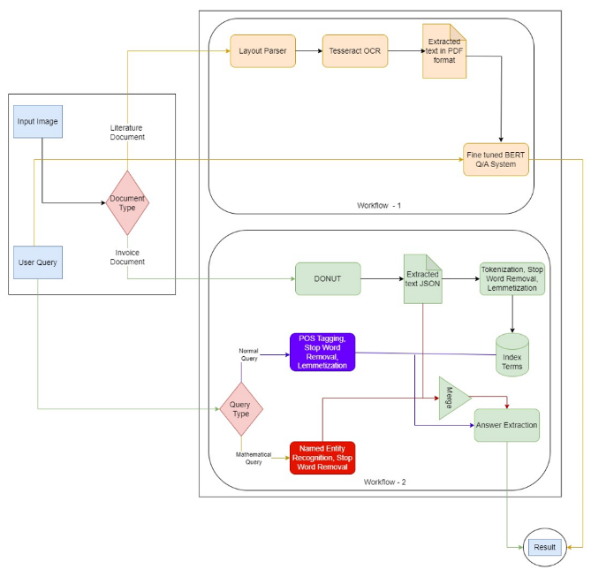
Workflow Diagram
Image to Text Interactive System for PDF Documents Ashutosh Rai – 2020BCS0020 Ashutosh Rai – 2020BCS0020

Slide 11
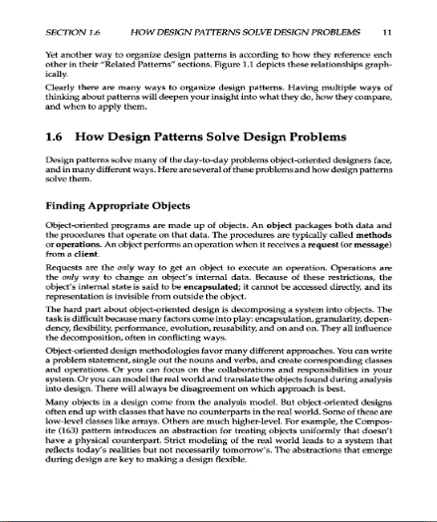
Experimental Results
Layout Parser:
Sample Input to Layout Parser:
Image to Text Interactive System for PDF Documents Ashutosh Rai – 2020BCS0020 Ashutosh Rai – 2020BCS0020

Slide 12
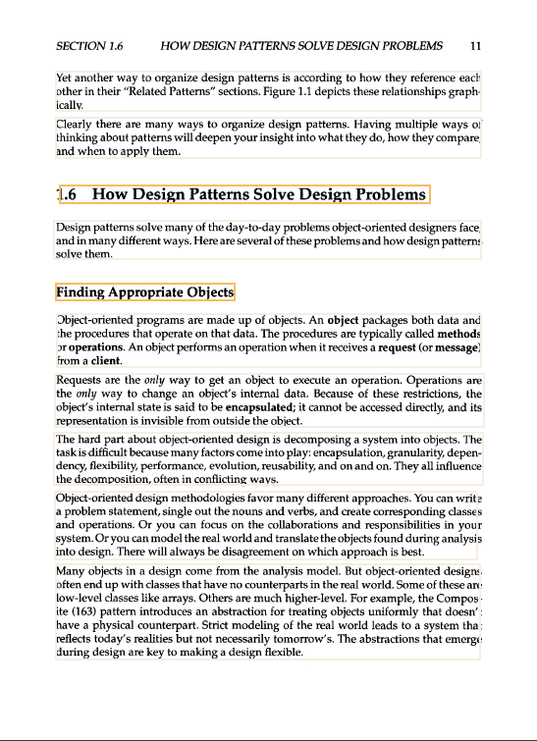
Experimental Results
Layout Parser:
Identified ROIs:
Image to Text Interactive System for PDF Documents Ashutosh Rai – 2020BCS0020 Ashutosh Rai – 2020BCS0020

Slide 13
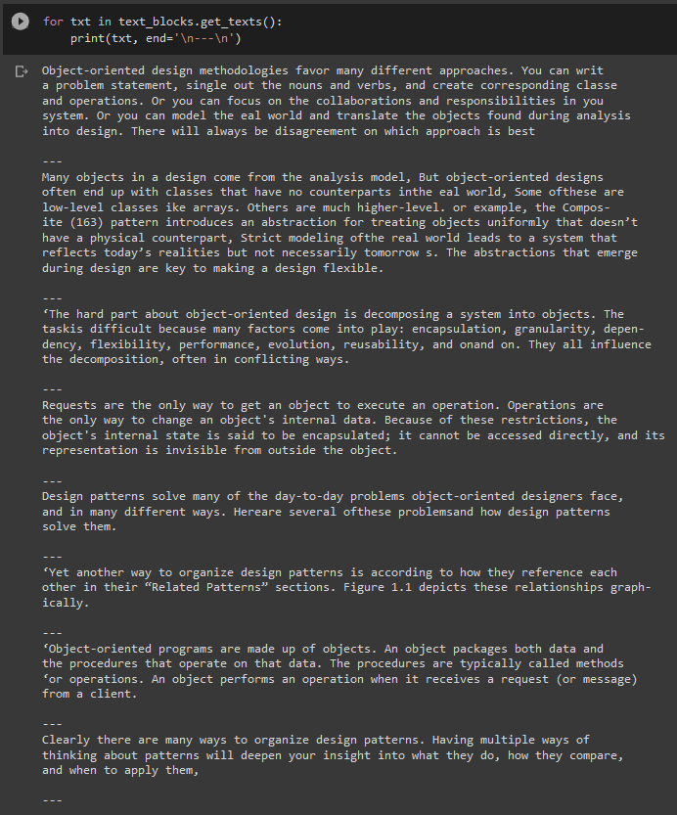
Experimental Results
Layout Parser:
Tesseract Output:
Image to Text Interactive System for PDF Documents Ashutosh Rai – 2020BCS0020 Ashutosh Rai – 2020BCS0020

Slide 14
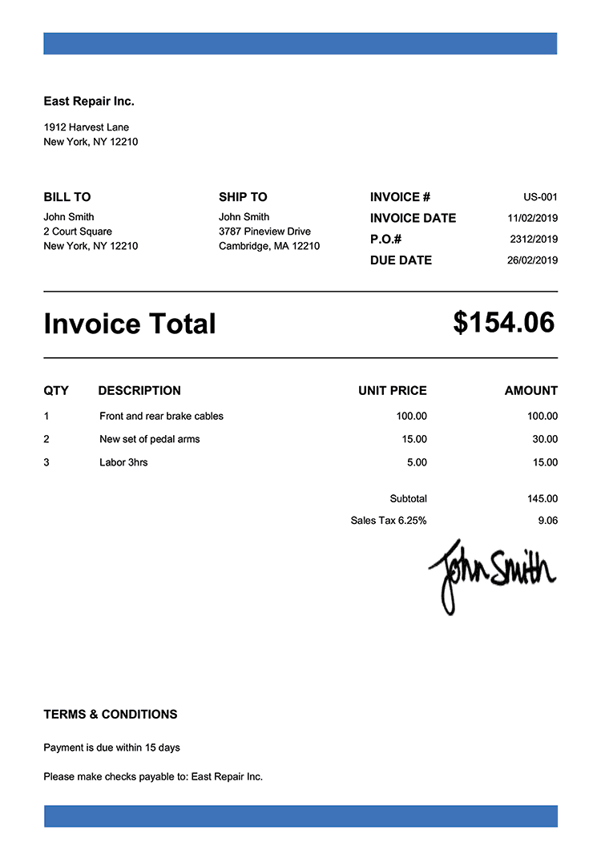
Experimental Results
DONUT:
Sample Input Invoice to DONUT:
Image to Text Interactive System for PDF Documents Ashutosh Rai – 2020BCS0020 Ashutosh Rai – 2020BCS0020

Slide 15
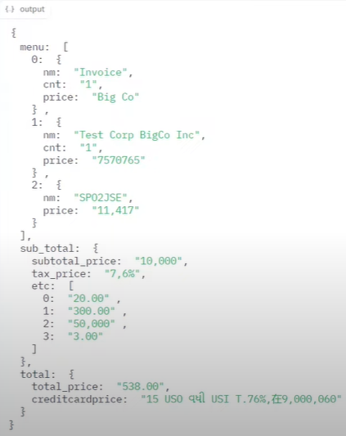
Experimental Results
DONUT:
Output Data Structure from DONUT parsed into JSON:
Image to Text Interactive System for PDF Documents Ashutosh Rai – 2020BCS0020 Ashutosh Rai – 2020BCS0020

Slide 16
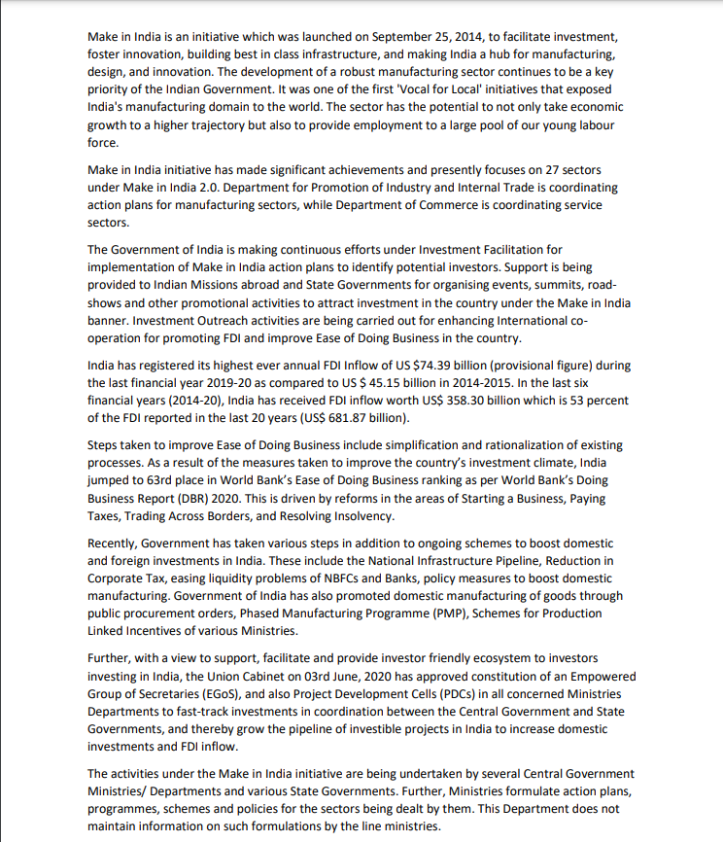
Experimental Results
Q/A System:
Sample Input Document to Q/A System:
Image to Text Interactive System for PDF Documents Ashutosh Rai – 2020BCS0020 Ashutosh Rai – 2020BCS0020

Slide 17
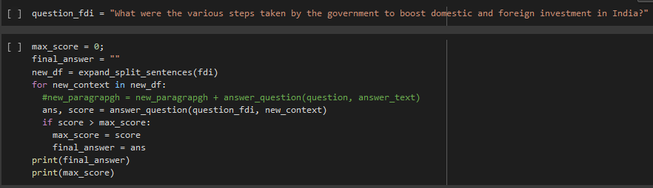
Experimental Results
Q/A System:
Output for user query:
Image to Text Interactive System for PDF Documents Ashutosh Rai – 2020BCS0020 Ashutosh Rai – 2020BCS0020

Slide 18
Experimental Results
Q/A System:
Output for user query:
Text: national infrastructure pipeline , reduction in corporate tax , easing liquid ##ity problems of n ##bf ##cs and banks , policy measures to boost domestic manufacturing
6.569849491119385
Image to Text Interactive System for PDF Documents Ashutosh Rai – 2020BCS0020 Ashutosh Rai – 2020BCS0020

Slide 19
Performance Measure
Tesseract:
The decision to use Tesseract OCR was based on a benchmarking test that evaluated its performance on a diverse dataset that included various document types and structures.
Multilingual support and easy integrability with other technology makes it reliable
Tesseract is a popular choice among researchers and developers due to its accuracy, speed, and versatility.
Category 1 – Web page screenshots that include texts Category 2 – Handwriting Category 3 – Receipts, invoices, and scanned contracts
Image to Text Interactive System for PDF Documents Ashutosh Rai – 2020BCS0020 Ashutosh Rai – 2020BCS0020

Slide 20
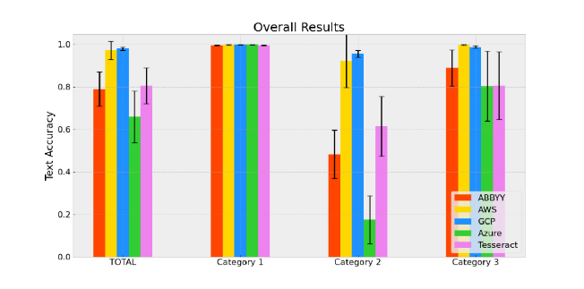
Performance Measure
[10]
Additionally, we can calculate the character error rate (CER) and word error rate (WER) by selecting a few sample sentences and words from the input presented in the Experimental Results:
Image to Text Interactive System for PDF Documents Ashutosh Rai – 2020BCS0020 Ashutosh Rai – 2020BCS0020

Slide 21
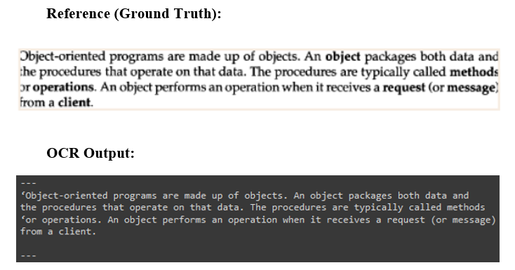
Performance Measure
Consider the following paragraph identified as ROI in the sample input:
Image to Text Interactive System for PDF Documents Ashutosh Rai – 2020BCS0020 Ashutosh Rai – 2020BCS0020

Slide 22
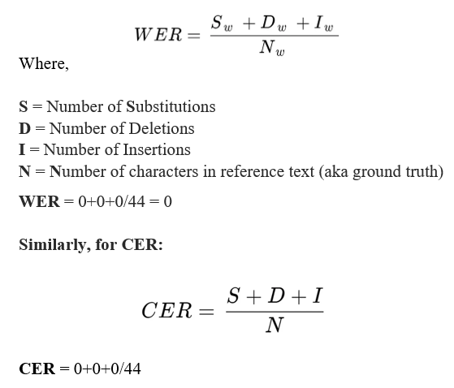
Performance Measure
Image to Text Interactive System for PDF Documents Ashutosh Rai – 2020BCS0020

Slide 23
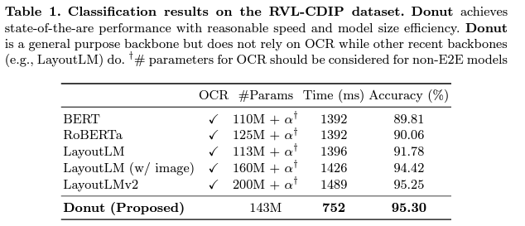
Performance Measure
DONUT:
[2]
Image to Text Interactive System for PDF Documents Ashutosh Rai – 2020BCS0020 Ashutosh Rai – 2020BCS0020

Slide 24
Conclusion
The proposed system leverages techniques like NLU, OCR, layout parsing, and VDU to improve the performance of document- level Q/A, but currently supports only two types of documents: literature and invoice.
Future work could include incorporating techniques like semantic parsing and paraphrasing, extending the system to handle more complex question types, and adding support for other document types and languages.
The system's accuracy and speed could be enhanced by incorporating feedback mechanisms and testing its scalability and robustness on larger and more diverse datasets.
Image to Text Interactive System for PDF Documents Ashutosh Rai – 2020BCS0020 Ashutosh Rai – 2020BCS0020

Slide 25
Conclusion
4. The proposed system has great potential in advancing the field of Q/A and can be an invaluable tool for document analysis, providing insights and answers that can significantly improve decision-making processes in various industries.
Image to Text Interactive System for PDF Documents Ashutosh Rai – 2020BCS0020 Ashutosh Rai – 2020BCS0020

Slide 26
References
Shen, Z., Zhang, R., Dell, M., Lee, B. C. G., Carlson, J., & Li, W. (2021). LayoutParser: A unified toolkit for deep learning based document image analysis. In Document Analysis and Recognition–ICDAR 2021: 16th International Conference, Lausanne, Switzerland, September 5–10, 2021, Proceedings, Part I 16 (pp. 131-146). Springer International Publishing.
Kim, G., Hong, T., Yim, M., Nam, J., Park, J., Yim, J., ... & Park, S. (2022, October). Ocr-free document understanding transformer. In Computer Vision–ECCV 2022: 17th European Conference, Tel Aviv, Israel, October 23–27, 2022, Proceedings, Part XXVIII (pp. 498-517). Cham: Springer Nature Switzerland.
Image to Text Interactive System for PDF Documents Ashutosh Rai – 2020BCS0020 Ashutosh Rai – 2020BCS0020

Slide 27
Hahn, U., & Oleynik, M. (2020). Medical information extraction in the age of deep learning. Yearbook of medical informatics, 29(01), 208-220.
Sen, J., Ozcan, F., Quamar, A., Stager, G., Mittal, A., Jammi, M., ... & Sankaranarayanan, K. (2019, June). Natural language querying of complex business intelligence queries. In Proceedings of the 2019 International Conference on Management of Data (pp. 1997-2000).
Tong, X., & Evans, D. A. (1996, June). A statistical approach to automatic OCR error correction in context. In Fourth workshop on very large corpora.
Shi, B., Bai, X., & Yao, C. (2016). An end-to-end trainable neural network for image-based sequence recognition and its application to scene text recognition. IEEE transactions on pattern analysis and machine intelligence, 39(11), 2298-2304.
Image to Text Interactive System for PDF Documents Ashutosh Rai – 2020BCS0020 Ashutosh Rai – 2020BCS0020

Slide 28
Park, S., Shin, S., Lee, B., Lee, J., Surh, J., Seo, M., & Lee, H. (2019, September). CORD: a consolidated receipt dataset for post-OCR parsing. In Workshop on Document Intelligence at NeurIPS 2019.
Huang, Z., Chen, K., He, J., Bai, X., Karatzas, D., Lu, S., & Jawahar, C. V. (2019, September). Icdar2019 competition on scanned receipt ocr and information extraction. In 2019 International Conference on Document Analysis and Recognition (ICDAR) (pp. 1516-1520). IEEE.
Devlin, J., Chang, M. W., Lee, K., & Toutanova, K. (2018). Bert: Pre-training of deep bidirectional transformers for language understanding. arXiv preprint arXiv:1810.04805.
https://research.aimultiple.com/ocr-accuracy
Image to Text Interactive System for PDF Documents Ashutosh Rai – 2020BCS0020 Ashutosh Rai – 2020BCS0020

Slide 29
Abnar, S., Bedrax-Weiss, T., Kwiatkowski, T., & Cohen, W. W. 2019). Incremental Reading for Question Answering. arXiv preprint arXiv:1901.04936.
Radev, D., Zhang, R., Rau, A., Sivaprasad, A., Hsieh, C., Rajani, N. F., ... & Socher, R. (2020). Dart: Open-domain structured data record to text generation. arXiv preprint arXiv:2007.02871.
Sun, K., Yu, D., Yu, D., & Cardie, C. (2018). Improving machine reading comprehension with general reading strategies. arXiv preprint arXiv:1810.13441.
Yang, M., Chen, L., Lyu, Z., Liu, J., Shen, Y., & Wu, Q. (2020). Hierarchical fusion of common sense knowledge and classifier decisions for answer selection in community question answering. Neural Networks, 132, 53-65.
Image to Text Interactive System for PDF Documents Ashutosh Rai – 2020BCS0020 Ashutosh Rai – 2020BCS0020

Slide 30
Thank you
Image to Text Interactive System for PDF Documents Ashutosh Rai – 2020BCS0020 Ashutosh Rai – 2020BCS0020

